Slide 1

CS-M151B
Computer Systems Architecture
Blaise Tine
UCLA Computer Science

Slide 2
Logistic
Bruinlearn
Campuswire

Slide 3

Attendance

Slide 4
The Power of Abstraction
What is an abstraction?
Common abstractions we use in computer science?

Slide 5
The Power of Abstraction
The classic OSI Model of Networking
Presentation layer
Session Layer
Transport Layer
Network Layer
Data Link Layer
Physical Layer
Application Layer
EMAIL
JPEG
RPC
TCP
IP
Ethernet
Cables

Slide 6
The Power of Abstraction
Hardware Abstraction
System Level
RTL Level
Gates Level
Transistors
MATMUL
FIFOs, MUXs , Arbiters
NAND Gate

Slide 7
The Power of Abstraction
Computer System Abstraction
System Libraries
OS Kernel
HAL
Hardware
Applications
Youtube
Video codecs
Media HAL
Media decoder

Slide 8
The Power of Abstraction
Computer System Abstraction
System Libraries
OS Kernel
HAL
Hardware
Applications
Youtube
Re-use
Video codecs
Scalability (apps)
Portability
Media HAL
Media decoder

Slide 9
The Power of Abstraction
Reduction of complexity
Modularity
Enhanced focus
Reusability
Scalability
Maintainability
Portability
Divergence
Separate growth

Slide 10
A basic computer model
Perform tasks
Input
Instructions
Data
Execution
Output
Result
Instructions
Computer
Output
Data

Slide 11
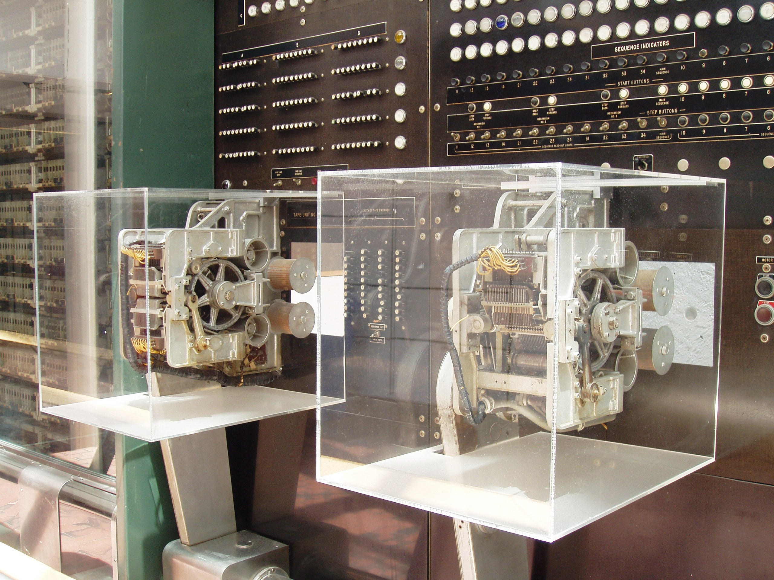
Early computers
Operated more like programmable calculators
Manual configuration using switches
Simple arithmetic
Instructions physical media
Punched cards
Electromechanical
e.g. Mark I
Storage 72 numbers
3 additions / sec
IBM Harvard Mark I (1940s)

Slide 12
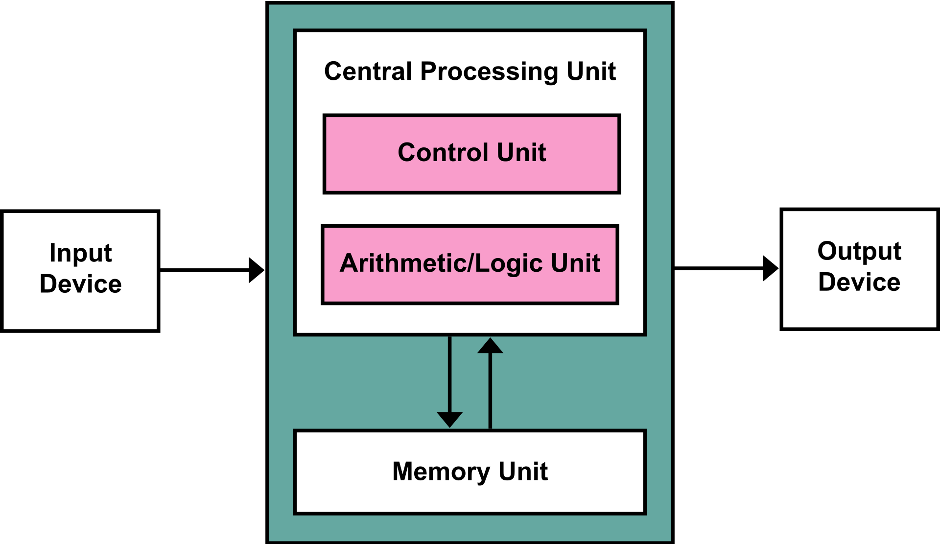
The Von-Newman Architecture
First digital computer model (1945)
Input device
Central processing unit (CPU)
Memory Unit
Output Device

Slide 13
The Von-Newman Architecture
Memory Unit
Digital storage
Store Instructions and data
Programmable
Flexibility

Slide 14
The Von-Newman Architecture
Single address space
Address Partitioning
Data region
Instruction region
I/O region
FFFF
Inputs/Ouputs
CPU
Instructions
8FFF
7FFF
Data
0000

Slide 15
The Von-Newman Architecture
Single address space
CPU microarchitecture
One program counter
Next instruction location
Single memory interface
Simple control logic
Shared system bus
Efficiency
FFFF
Inputs/Ouputs
CPU
Instructions
8FFF
7FFF
PC
Data
0000

Slide 16
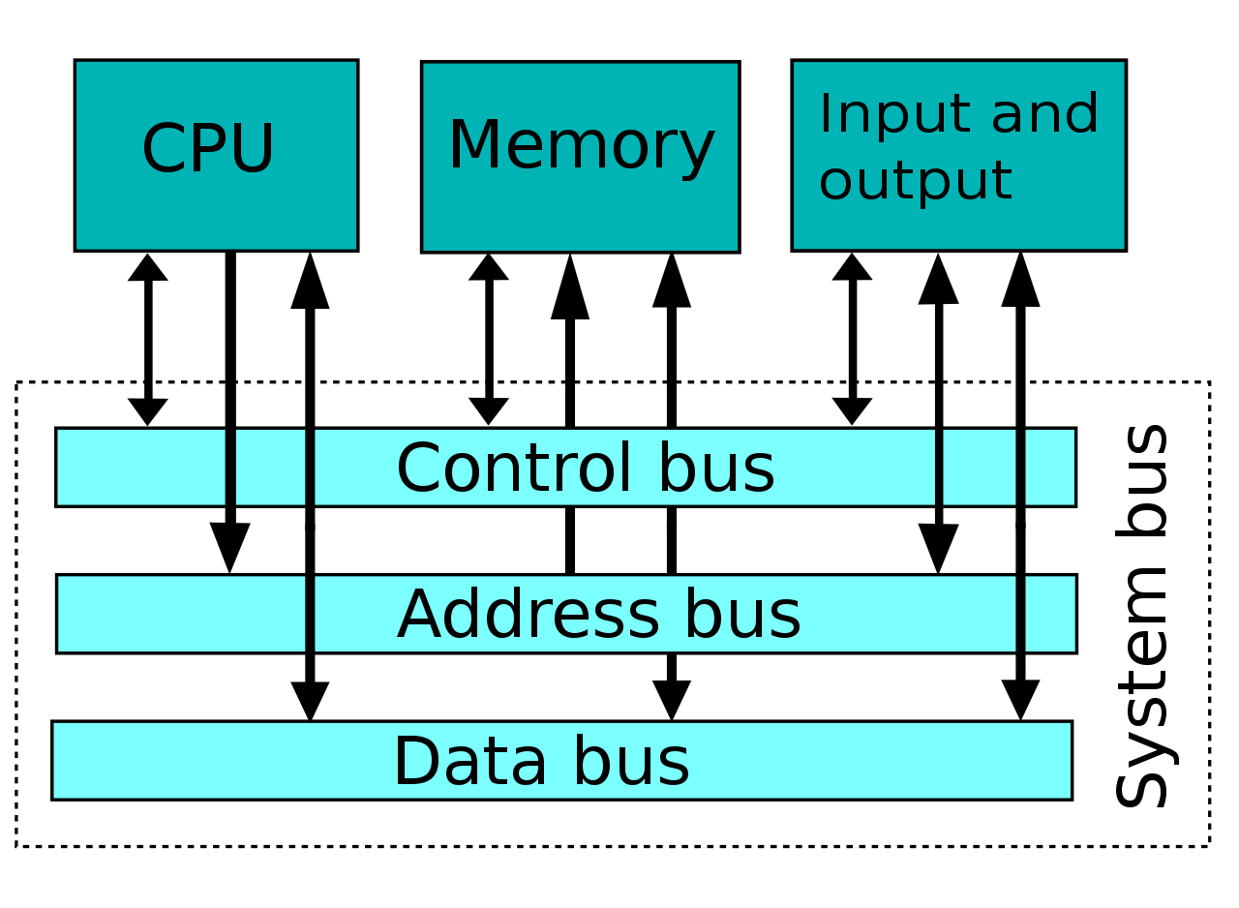
The Von-Newman Architecture
System Bus
Address bus
Specify memory address
Data bus
Specify data to transfer
Control bus
Schedule transfer

Slide 17
The Von-Newman Architecture
Limitations
Shared bus bottleneck
Too many connected devices
Control switching
One instruction at the time

Slide 18
The Von-Newman Architecture
Sample Exercise:
Assume following system bus design
2-bit control bus [O][S]
O: read/write enable
0 => read
1 => write
S: chip select
0 => Memory
1 => I/O
32-bit address bus
8-bit data bus

Slide 19
The Von-Newman Architecture
Sample Exercise:
CPU wants to read a byte from memory at address 0x80000000
Step1: CPU places 0x80000000 on address bus.
Step2: CPU selects memory for read by placing 00 on control bus
R=0, S=0
Step3: Memory loads the byte at specified address location in memory and puts it on the data bus
Step4: CPU reads the byte from the data bus

Slide 20
The Von-Newman Architecture
Sample Exercise:
CPU wants to write a byte to I/O at address 0xFF000000
Step1: CPU places 0xFF000000 on address bus.
Step2: CPU places the byte to be sent on the data bus
Step3: CPU selects I/O for write by placing 11 on control bus
O=1, S=1
Step4: I/O reads byte from the data bus and stores it to the specified address location in I/O

Slide 21
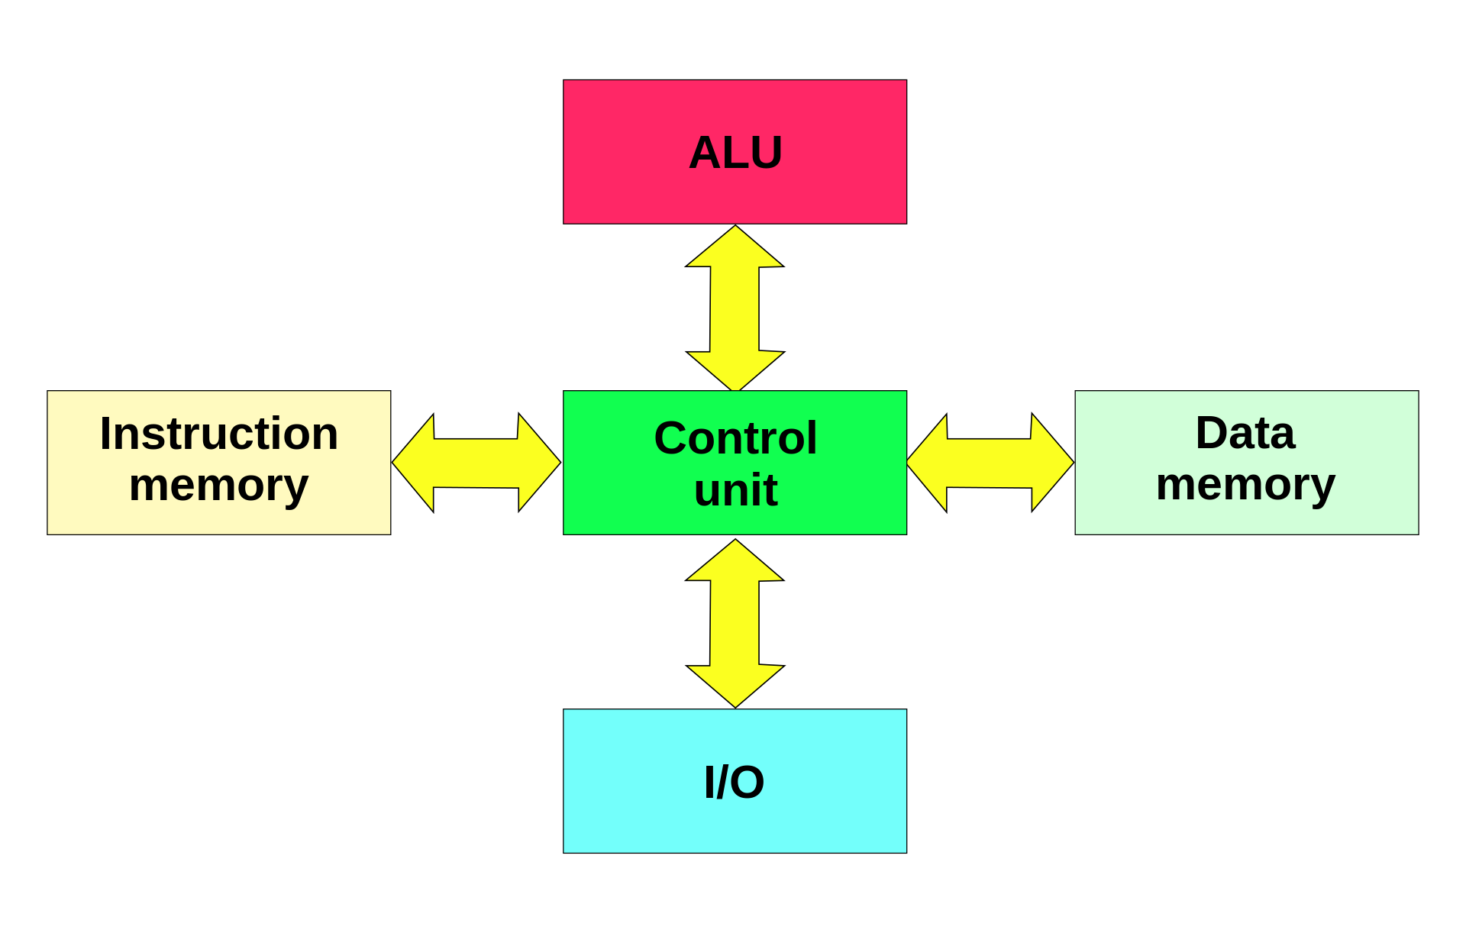
The Von-Newman Architecture
Harvard Architecture Model
Separate memory buses
Instruction memory
Data memory

Slide 22
The Von-Newman Architecture
Harvard Architecture Model
Advantages
Simultaneous access
Fetch data and instructions in parallel
Increases performance
Can specialize instruction memory
Can be read-only (security)
Can be non-volatile (flexibility)
Can be faster technology (speed)

Slide 23
The Von-Newman Architecture
Harvard Architecture Model
Limitations
Complexity and cost
Multiple memory buses
Flexibility
Self-modifying code

Slide 24
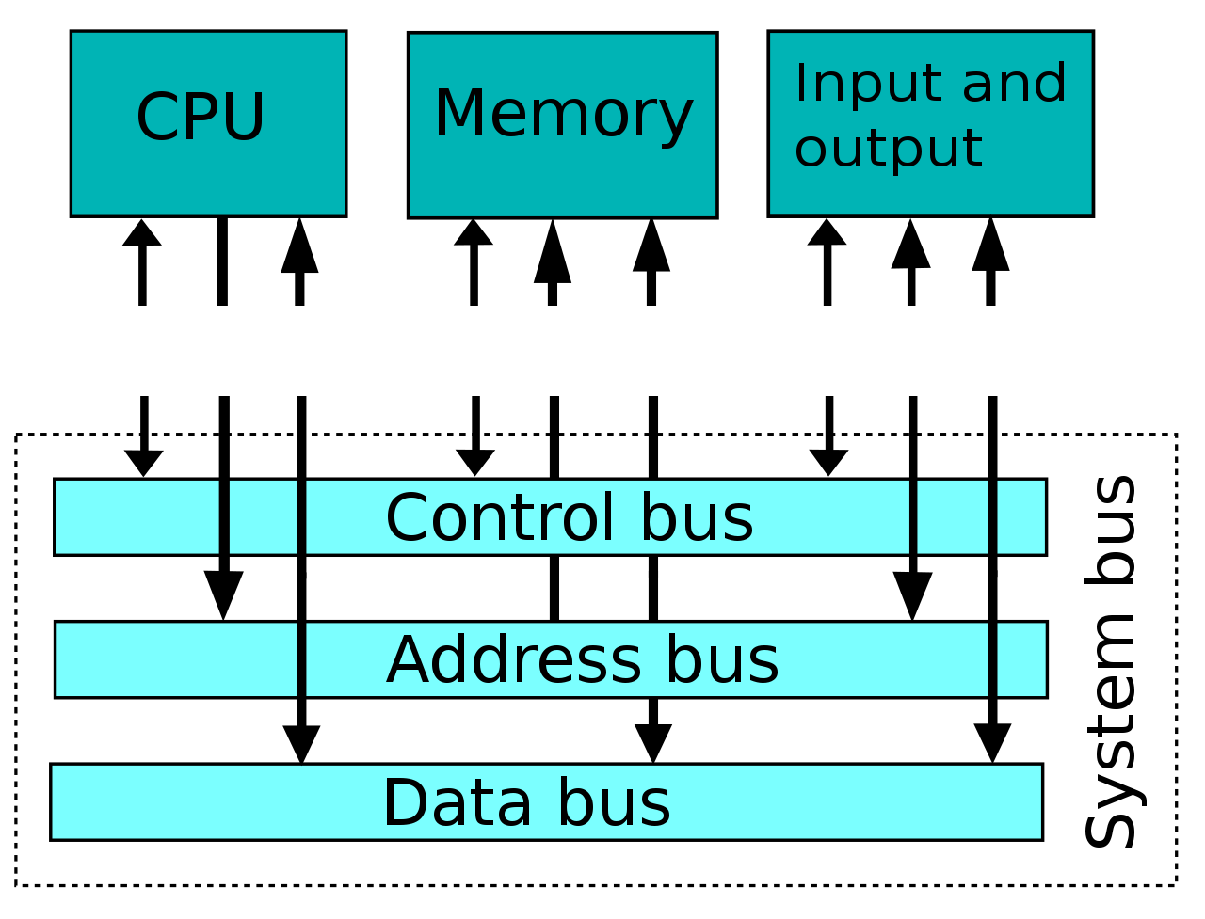
The Von-Newman Architecture
Von-Newman “bottleneck”
High memory access latency
High I/O latency
High CPU idle time
Waiting for memory or I/O
<10 cycles
>100 cycles
>10000 cycles

Slide 25
The Von-Newman Architecture
Mitigations
Caches
Instruction cache
Data cache
On-chip memory
I/O
Data cache
Or bypass
Less traffic
Typically not on critical path
CPU
Control
Logic
ALU
I-Cache
D-Cache
Memory

Slide 26
The Von-Newman Architecture
Registers (~1KB, 0.3ns)
L1 cache (~256KB, ~1.1ns)
L2 cache (~1 MB, ~5ns)
L3 cache (~8 MB, ~15ns)
L4 cache (~128MB, ~40ns)
Memory (~32GB, ~60ns)
Memory wall
The problem still present today
Worsen by multicore
We use deeper caches
Cache area getting larger than CPU

Slide 27
Writing the program
Simply write machine code
Early software
Disadvantages
Hard to write
Difficult to debug
01010101010101010101
CPU

Slide 28
Writing the program
Simply write machine code
Possible advantages?
Full h/w control
Can write efficient code
01010101010101010101
CPU

Slide 29
Writing the program
void main() {
print(“Hello world!”);
}
Use a high-level language
C++, Fortran, Python
Higher abstraction
Closer to the problem domain
Objects and algorithms
C++ Compiler
mov r0 r1
add r2 r0 r1
mul r1 r3 r2

Slide 30
Writing the program
Compiler
Convert to assembly code
Enable advanced optimizations
Requiring program analysis
Difficult to do by manually
void main() {
print(“Hello world!”);
}
C++ Compiler
mov r0 r1
add r2 r0 r1
mul r1 r3 r2

Slide 31
Writing the program
Assembly code
Textual representation of instructions
Depend on target machine architecture
void main() {
print(“Hello world!”);
}
C++ Compiler
mov r0 r1
add r2 r0 r1
mul r1 r3 r2

Slide 32
Writing the program
mov r0 r1
add r2 r0 r1
mul r1 r3 r2
Assembler
Convert assembly code to machine code
Machine code contains encoded binary
Instructions and data
Why is this step separate from the compiler?
Assembler
001010101010101010101010101010101010101010101010101010111110

Slide 33
Writing the program
mov r0 r1
add r2 r0 r1
mul r1 r3 r2
Machine code variations
Context-specific pseudo instructions
Context-specific macro expansion
Can depend on the platform or machine
Assembler
A
Assembler
B
001010101010101010101010101011111111111111111111111
001010101010101010101010101010101011010101010101
binary A
binary B

Slide 34
Writing the program
Software portability challenges
Using different CPUs
Using different Operating Systems
void main() {
print(“Hello world!”);
}
OS-1
OS-2
CPU
A
CPU
B

Slide 35
Writing the program
void main() {
print(“Hello world!”);
}
Software Abstraction layers
Instruction Set Architecture
Application Binary Interface
Compiler
ABI
Operating System
ISA
Hardware

Slide 36
Writing the program
void main() {
print(“Hello world!”);
}
Application Binary Interface
A contract between S/W and OS
Binary compatibility
Can OS launch App A
Can App A interact with App B
How?
Function calls convention
Stack frame organization
Binary object format
Etc..
Compiler
ABI
Operating System
ISA
Hardware

Slide 37
Writing the program
void main() {
print(“Hello world!”);
}
Instruction Set Architecture
A contract between S/W and H/W
Software/Hardware divergence
Can evolve independently
Hardware abstraction
H/w Simulation
Compiler
ABI
Operating System
ISA
Hardware

Slide 38
Writing the program
void main() {
print(“Hello world!”);
}
Instruction Set Architecture
S/W view
Operations
Storage locations
Hardware view
Instructions
Data
Compiler
ABI
Operating System
ISA
Hardware

Slide 39
Instruction Set Architecture
Background
IBM System/360 architecture (1964)
First introduction of separation between H/W and S/H
Features
Complex Instruction Set Computer (CISC)
16 * 32-bit general-purpose registers
4 * 64-bit floating-point registers

Slide 40
Instruction Set Architecture
Mainstream ISA’s
x86/x86-64 (AMD64) ISA: Intel, AMD
ARM ISA: Apple, Samsung, Qualcomm
MIPS ISA: Embedded systems, network routers, etc..
SPARC ISA: Sun Microsystems
RISC-V ISA: SiFive, academia, enthusiasts

Slide 41
Computer Storage Model
Register File
Hold a number of register slots
Very fast (<3 cycles)
Expensive
Small (KB)
Inside the CPU
Memory
Very slow (> 100 cycles)
Cheaper
Larger (GB)
Outside the CPU
ALU’s
Register File
Memory

Slide 42
Computer Execution Model
Basic Instruction Format
Opcode
Type of operation
e.g. ADD, MUL
Operands
Source data to use
register identifier (e.g. r0)
Or memory address (e.g. 0x8000)
OPCODE
OPERANDS

Slide 43
Computer Execution Model
Fetch
Fetch next instruction
From program counter (PC)
Decode
Extract opcode & operands
Execute
Perform the operation
Update
PC and memory
Fetch
Decode
Execute
Update

Slide 44
How do you design an ISA?
How fast can we fetch?
How fast can we decode?
How fast can we execute?
How efficient will the hardware be?
Fetch
Decode
Execute
Update

